Slide 1
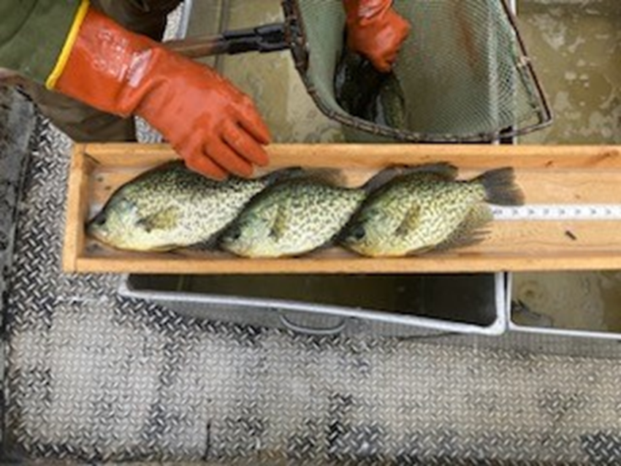
Pike Lake Chain
Kendal Patrie
WDNR- Fish Management Team

Slide 2
Experimental Panfish Regulations Expired
2016-2026
25/10
  Total of 25 panfish but no more than 10 of any one species

Slide 3
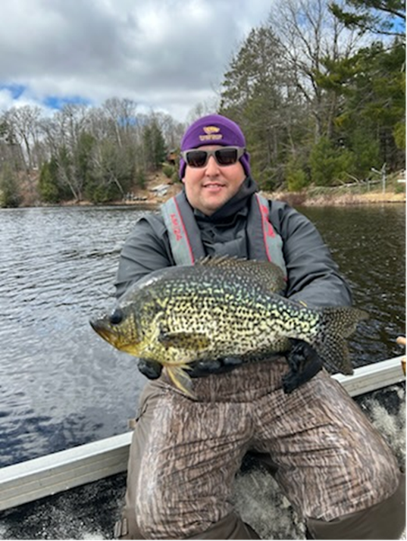
Panfish Survey Design
Fisheries and Social Science teamed up
Developed questions
Random angler survey
Lake Association link
Results

Slide 4
Survey Options
No preference
Option 1: 25 Panfish (any species)
Option 2: 10 Panfish (any species)
Option 3: 25 Panfish (only 5 bluegills)
Option 4: 25 Panfish ( only 5 crappies)
Option 5: 10 Panfish (only 5 bluegills)
Option 6: 10 Panfish (only 6 crappies)

Slide 5
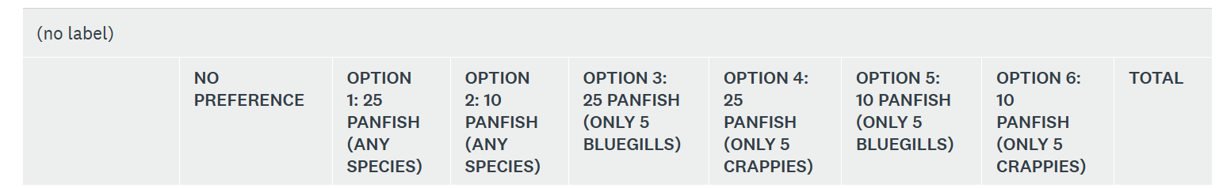
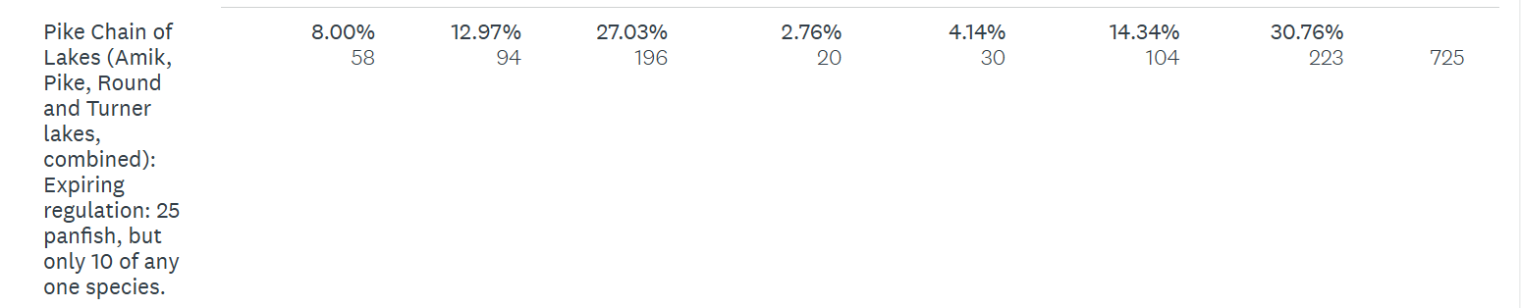
For each of the following lakes, please indicate your preferred regulation for panfish.

Slide 6
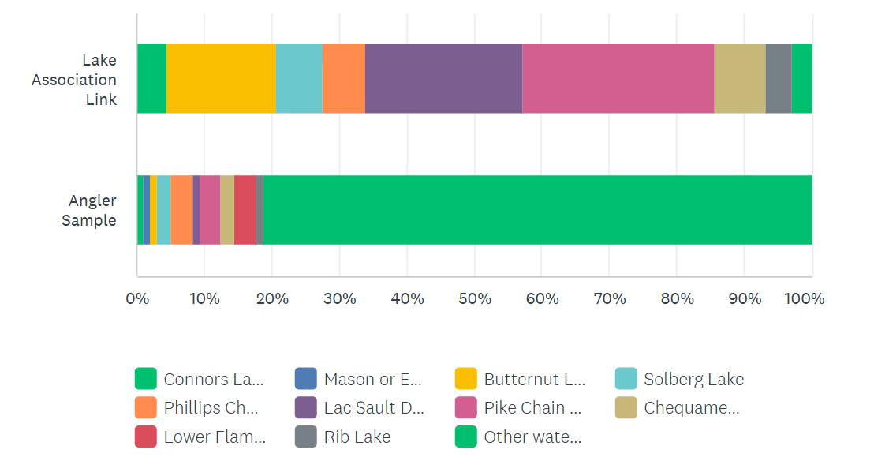
On which of the following water does your lake association focus its primary attention?
Pike Chain
  Lake Association Link
    28.48% 88 responses
  Angler Sample
    3.13% 3 responses

Slide 7
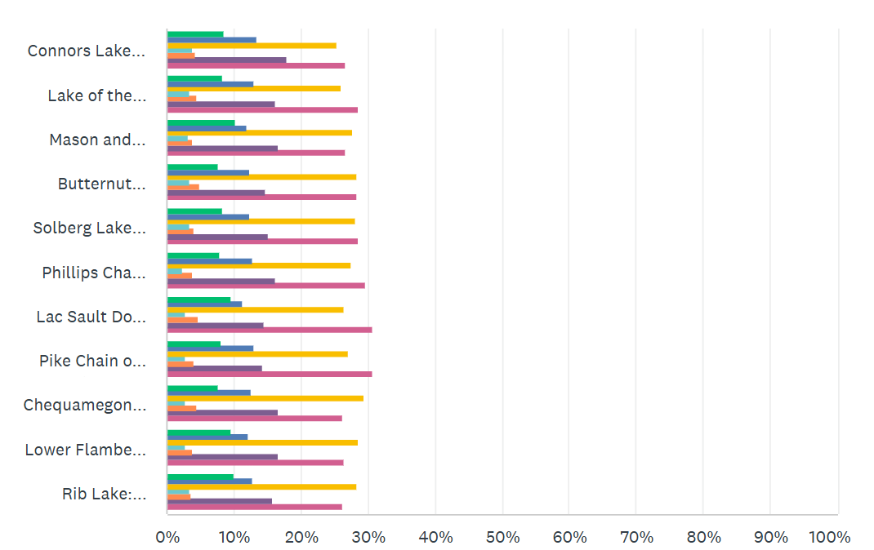
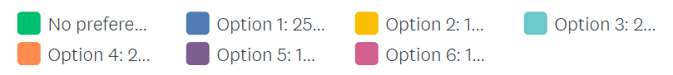
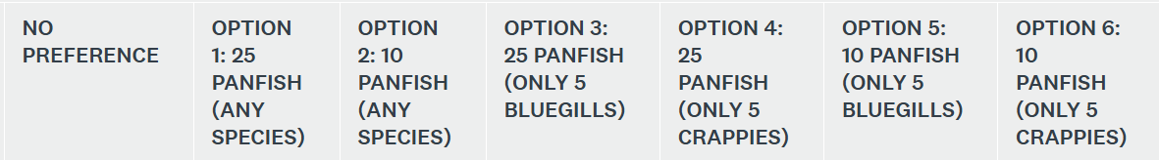
Preferred regulation for panfish

Slide 8
What's Next
DNR submitted a regulation change proposal in winter 2026
  10 panfish bag limit
  Question submitted for the 2027 Spring Hearings
  If passed, goes in effect April 1, 2028

Slide 9
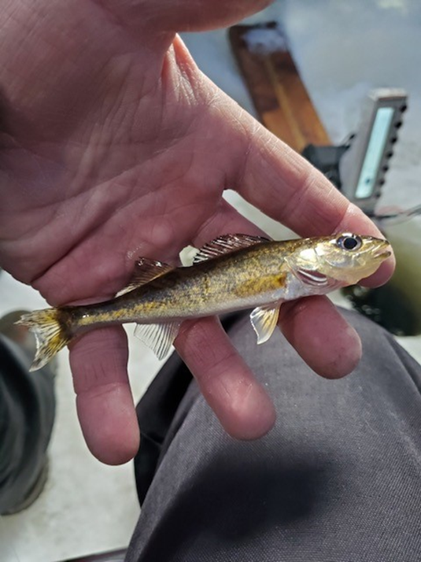
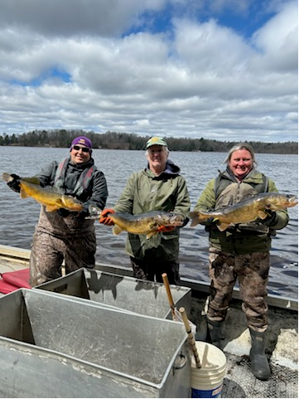

Slide 10
Walleye Survey Spring 2025
 | Acreage | Population Estimate | Total Handled | Size Range
April 15-19, 2025 |  | Adults per acre
Round | 726 | 7.1 (Moderate to High Abundance) | 1043 | 8.9-24.8"
Pike | 806 | 1.6 (Low to Moderate) | 284 | 8.7-24.3"
Turner | 149 | 1.3 (Low to Moderate) | 31 | 12.6-23.3"
Amik | 224 | 4 (Moderate) | 140 | 10.6-28.4"
Includes recapped fish

Slide 11
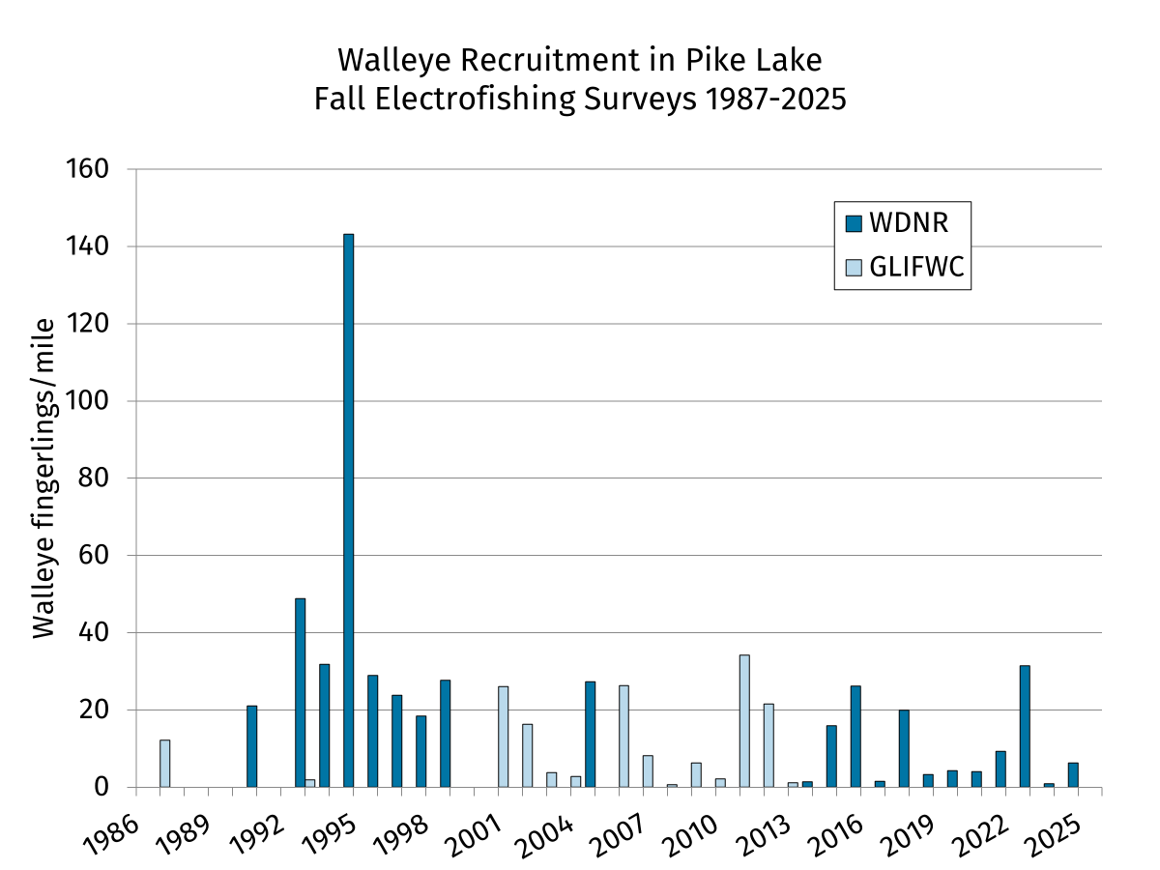

Slide 12
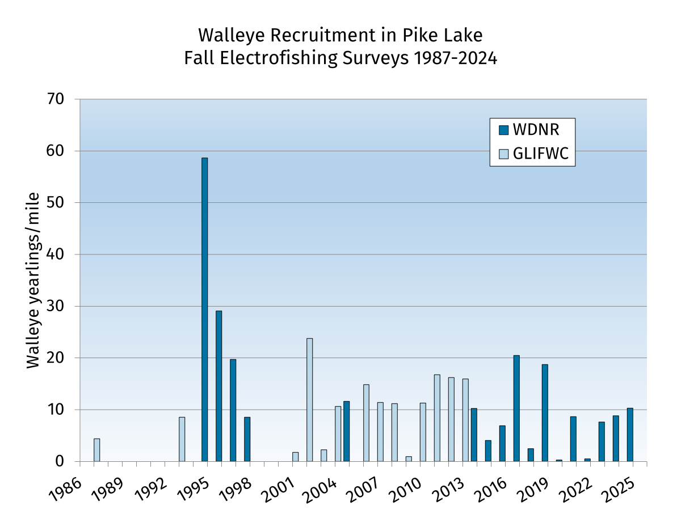

Slide 13
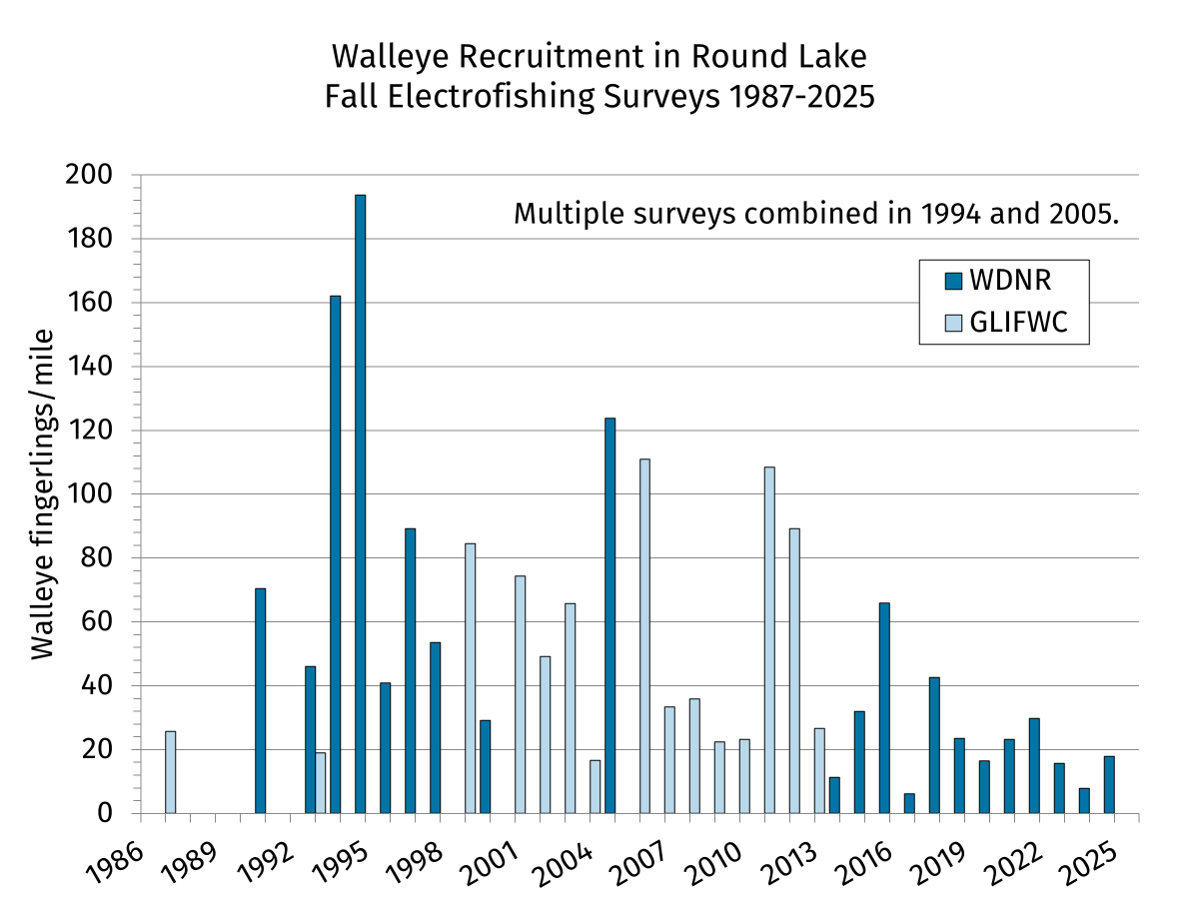

Slide 14
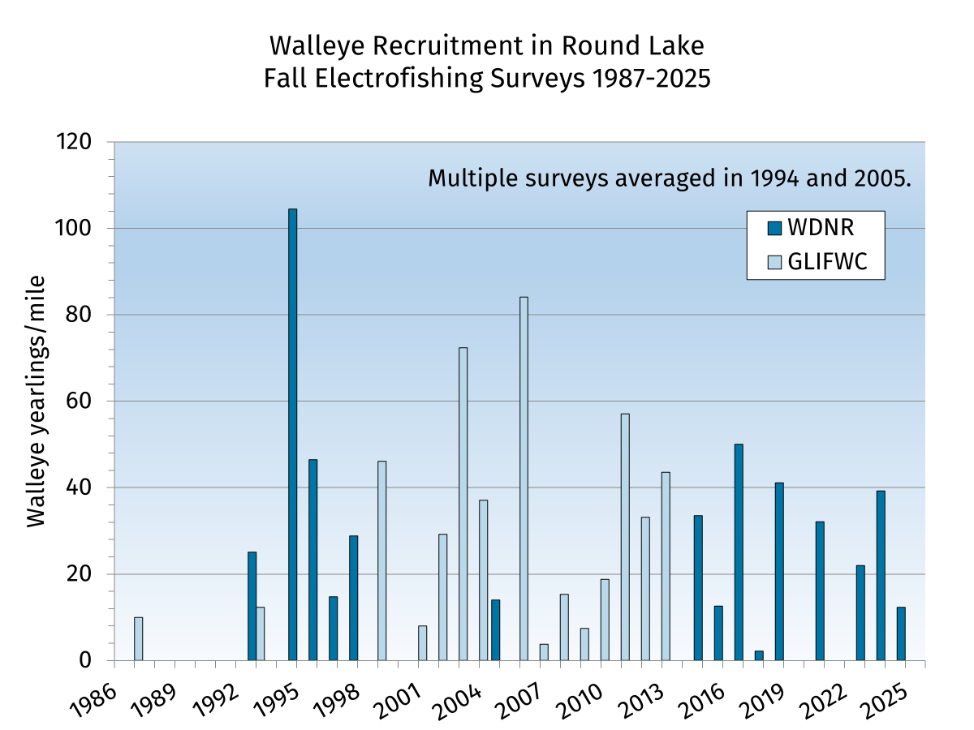

Slide 15
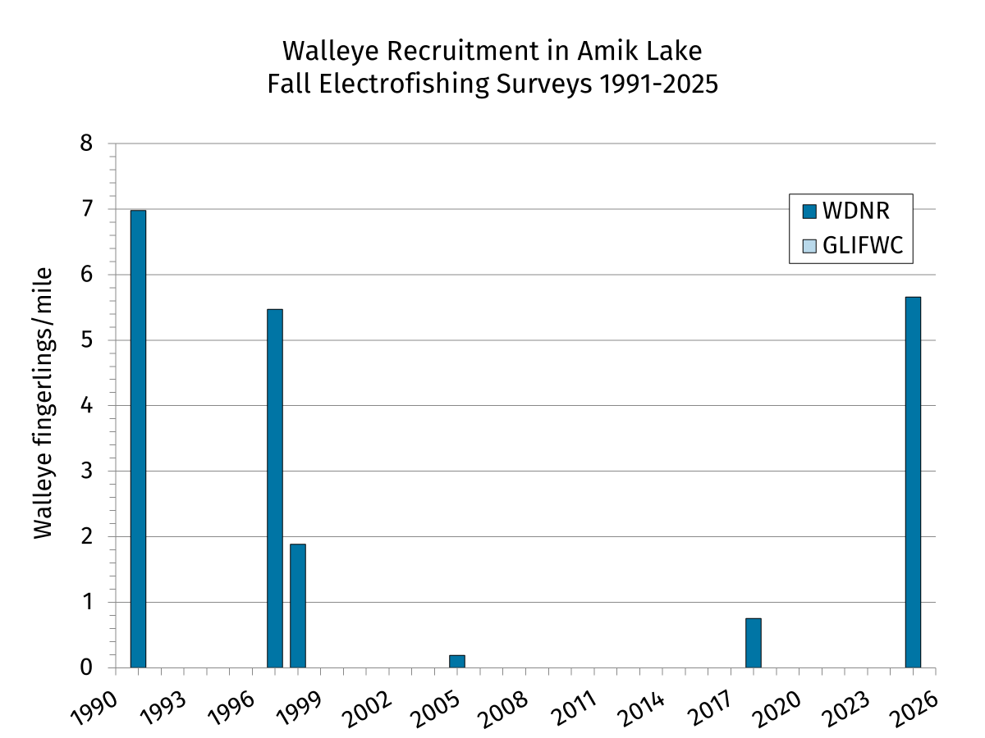

Slide 16
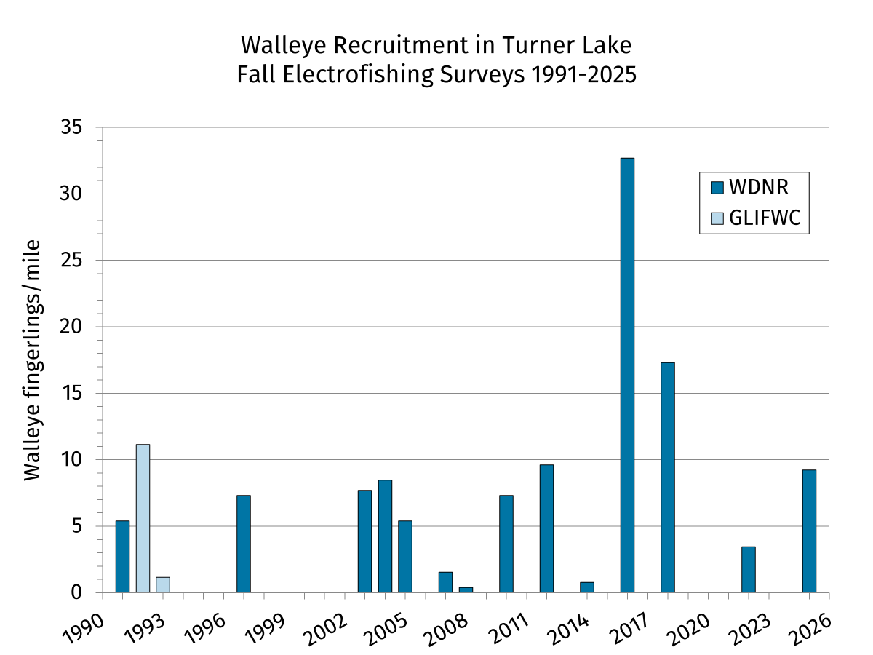

Slide 17
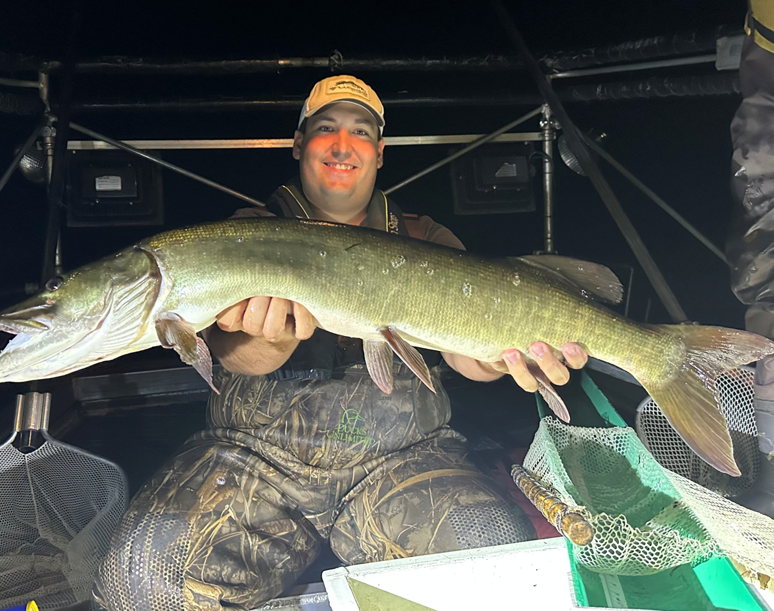
Tuner Lake Muskellunge

Slide 18
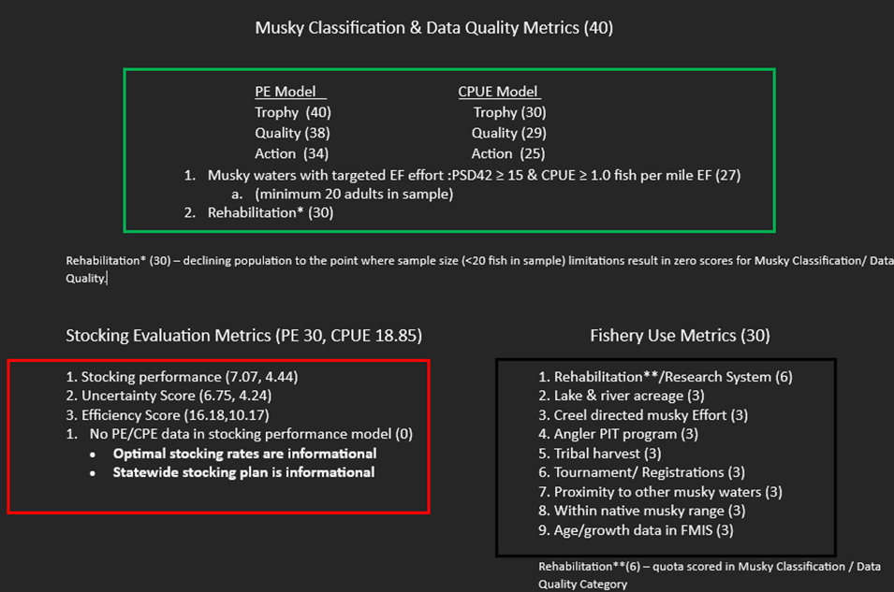
Musky Stocking (new rating system 2026)

Slide 19
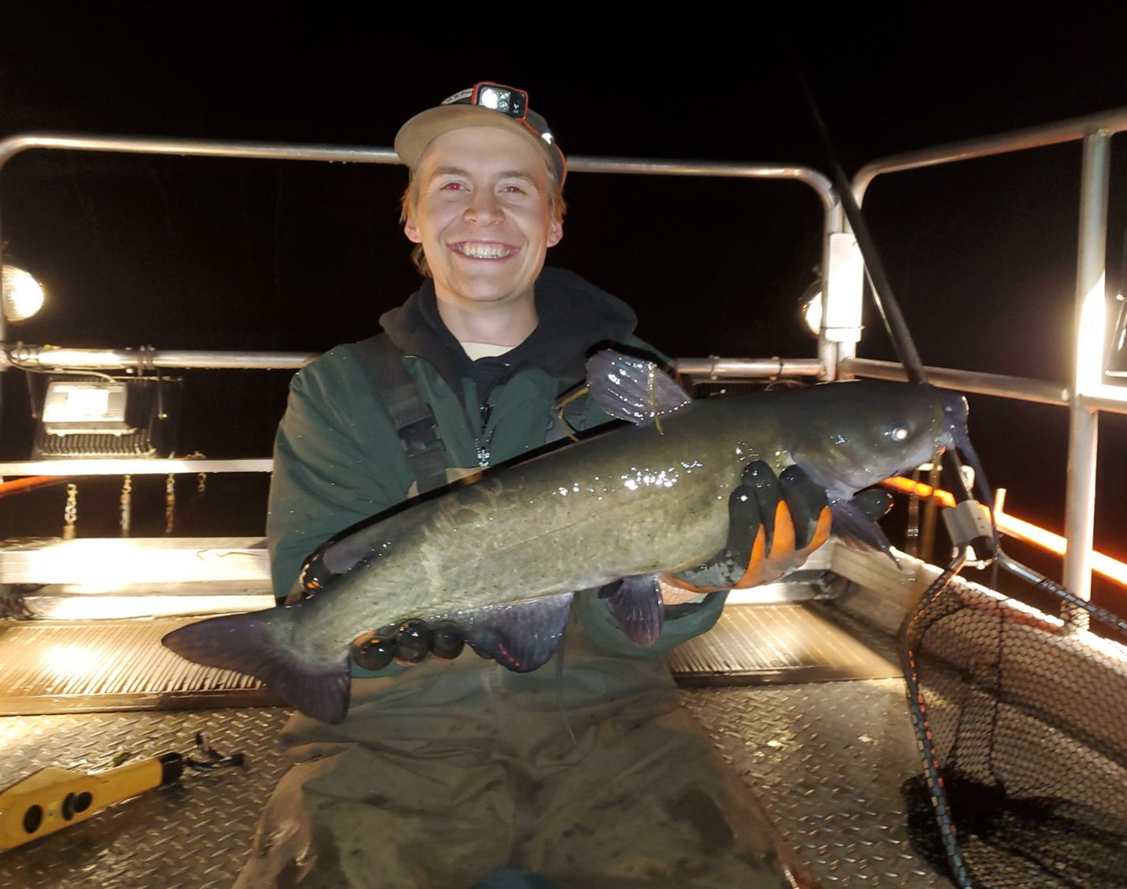
Round Lake Channel Catfish

Slide 20
Future Surveys
Round and Pike continue with yearly fall recruitment surveys
Next rotation 2031

Slide 21
Kendal Patrie
Fisheries Biologist
Kendal.Patrie@wisconsin.gov
715-492-5466

